Slide 1
Chapter 13: I/O Systems

Slide 2
Chapter 13: I/O Systems
I/O Hardware
Objective: Explore the structure of an operating system’s I/O subsystem

Slide 3
I/O Hardware
Incredible variety of I/O devices
Common concepts
  Port
  Bus (daisy chain or shared direct access)
  Controller (host adapter)
I/O instructions control devices
Devices have addresses, used by
  Direct I/O instructions
  Memory-mapped I/O

Slide 4
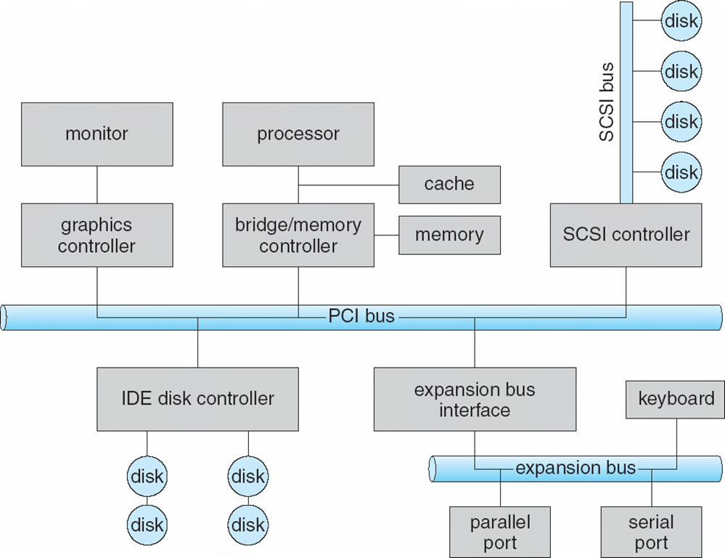
A Typical PC Bus Structure

Slide 5
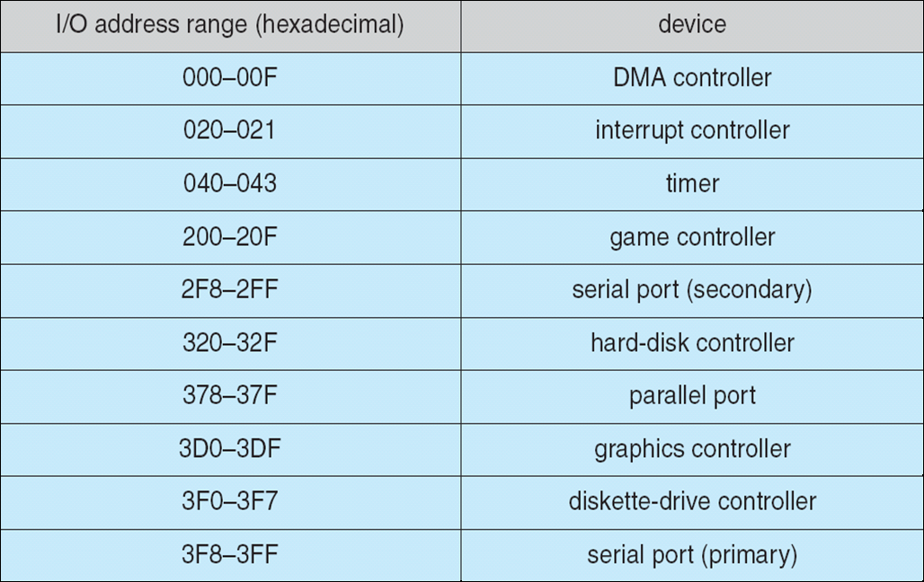
Device I/O Port Locations on PCs (partial)

Slide 6
Polling
Determines state of device
  command-ready
  busy
  Error
Busy-wait cycle to wait for I/O from device

Slide 7
Interrupts
CPU Interrupt-request line triggered by I/O device
Interrupt handler receives interrupts
Maskable to ignore or delay some interrupts
Interrupt vector to dispatch interrupt to correct handler
  Based on priority
  Some nonmaskable
Interrupt mechanism also used for exceptions

Slide 8
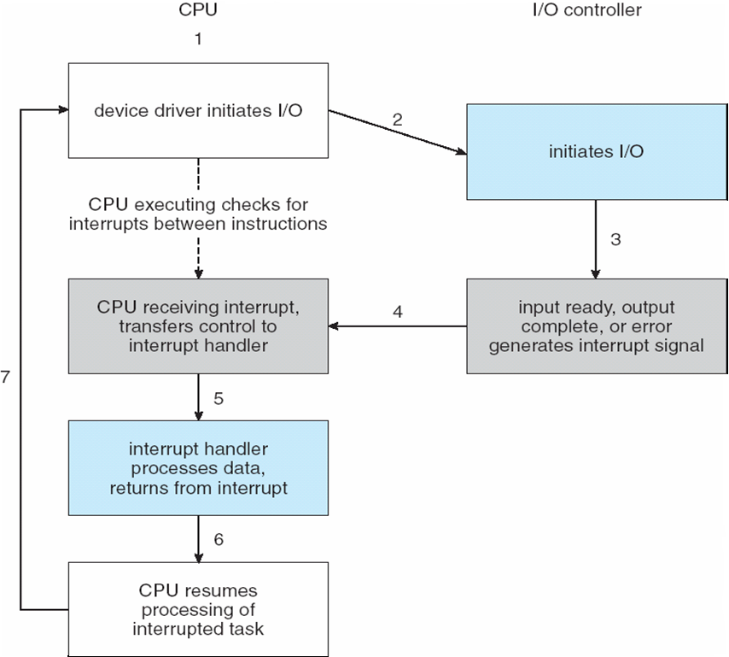
Interrupt-Driven I/O Cycle

Slide 9
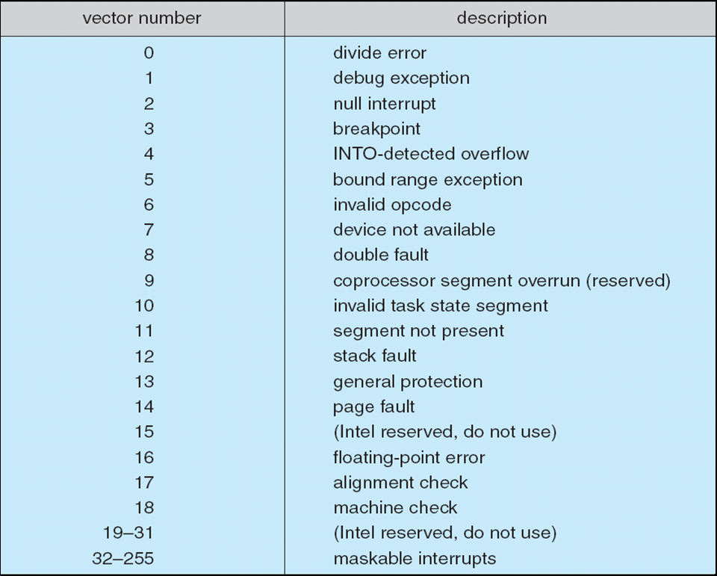
Intel Pentium Processor Event-Vector Table

Slide 10
Direct Memory Access
Used to avoid programmed I/O for large data movement
Requires DMA controller
Bypasses CPU to transfer data directly between I/O device and memory

Slide 11
Clocks and Timers
Provide current time, elapsed time, timer
Programmable interval timer used for timings, periodic interrupts
ioctl (on UNIX) covers odd aspects of I/O such as clocks and timers

